Slide 1

Mathenian A Math Practice Application

Slide 2
Introduction
“I’m bad at maths”
“I’m just not a math person”
Learning math is like learning a language, it takes practice
Introducing Mathenian
Simple concepts
Mobile app
Notes:
Prove to myself that I could pick a project and stick to it
Design oriented

Slide 3
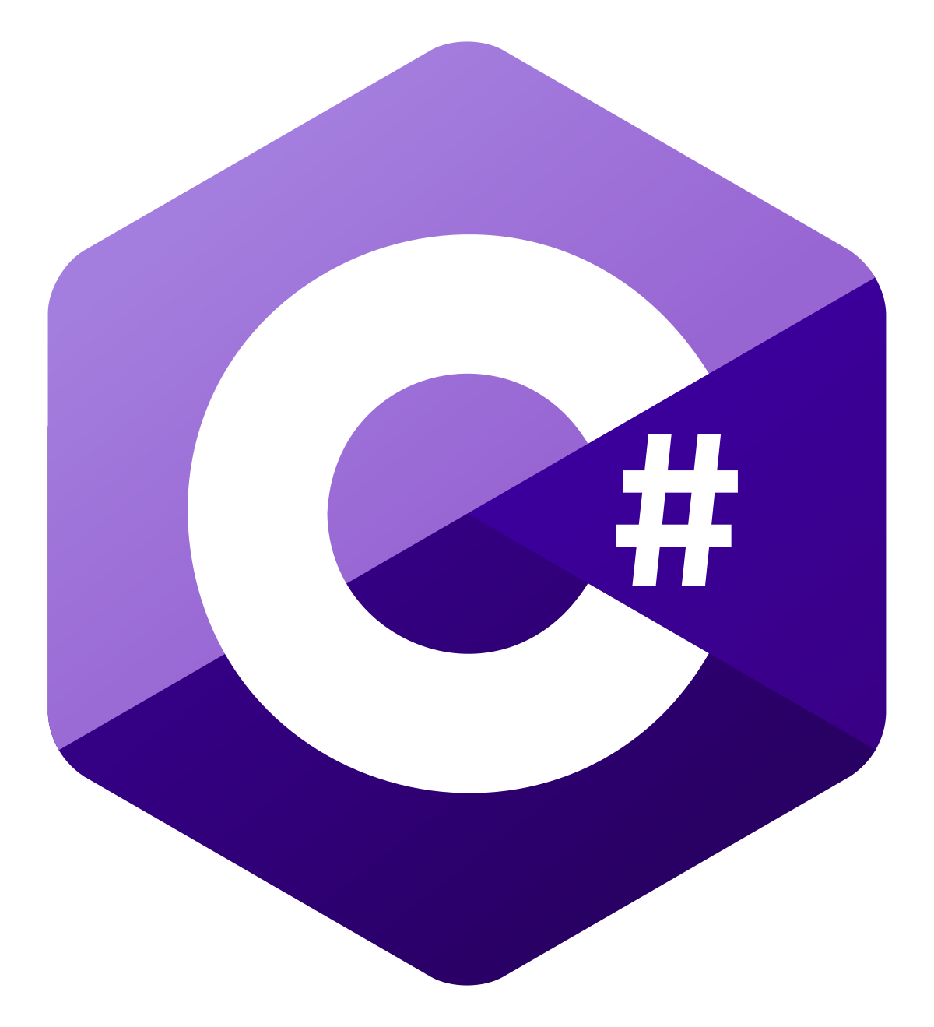
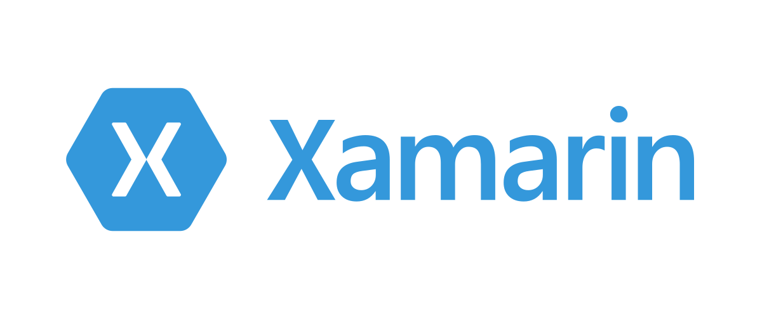

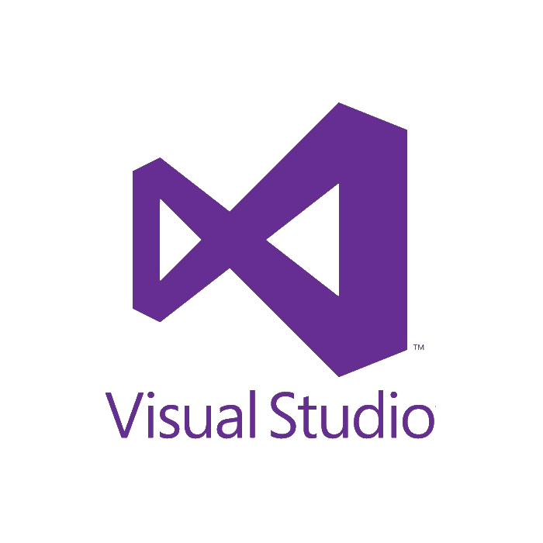

Technologies
Language: C#, XAML
Platform: Xamarin.Forms
Database: SQLite
IDE: VS19
Source Control: Git on Github
Notes:
C# - Used Java in JP, new language to properly pickup
Xamarin.Forms – New platform, curious about writing shared code
SQLite – Simple but effective

Slide 4
Subsystem Diagram (MVVM Design)
Notes:
Discuss MVVM

Slide 5
Executive Class Diagram
Notes:
Ping pong between slides, note that VMs use these

Slide 6
Demo + Code Presentation

Slide 7
Summary
Easier:
Picking up C#
Breaking up project into tasks
Harder:
Maintaining progress according to project plan
Upgrading packages
Do Differently:
Start on and remain on set package versions
Output math notation in LaTeX format
Notes:
Easier:
Picking up a new language and reading through documentation – good foundation from C++
Work experience helped with breaking projects – know how much work could be truly done in 10 weeks
Harder:
Following timelines
Many issues with packages
Differently:
Set packages
Use CSharpMath to render instead of plaintext
Scale up – non-local db, iOS app

